Slide 1
Presentation
Xgboost in US traffic analysis
Professor Wonjun Lee
Hui Du & Matthew Choi
COMP542 Machine Learning

Slide 2
CONTENTS
1
2
3
4
5
Introduction
Models
Implementation
Result
Q/A

Slide 3
01
Introduction

Slide 4
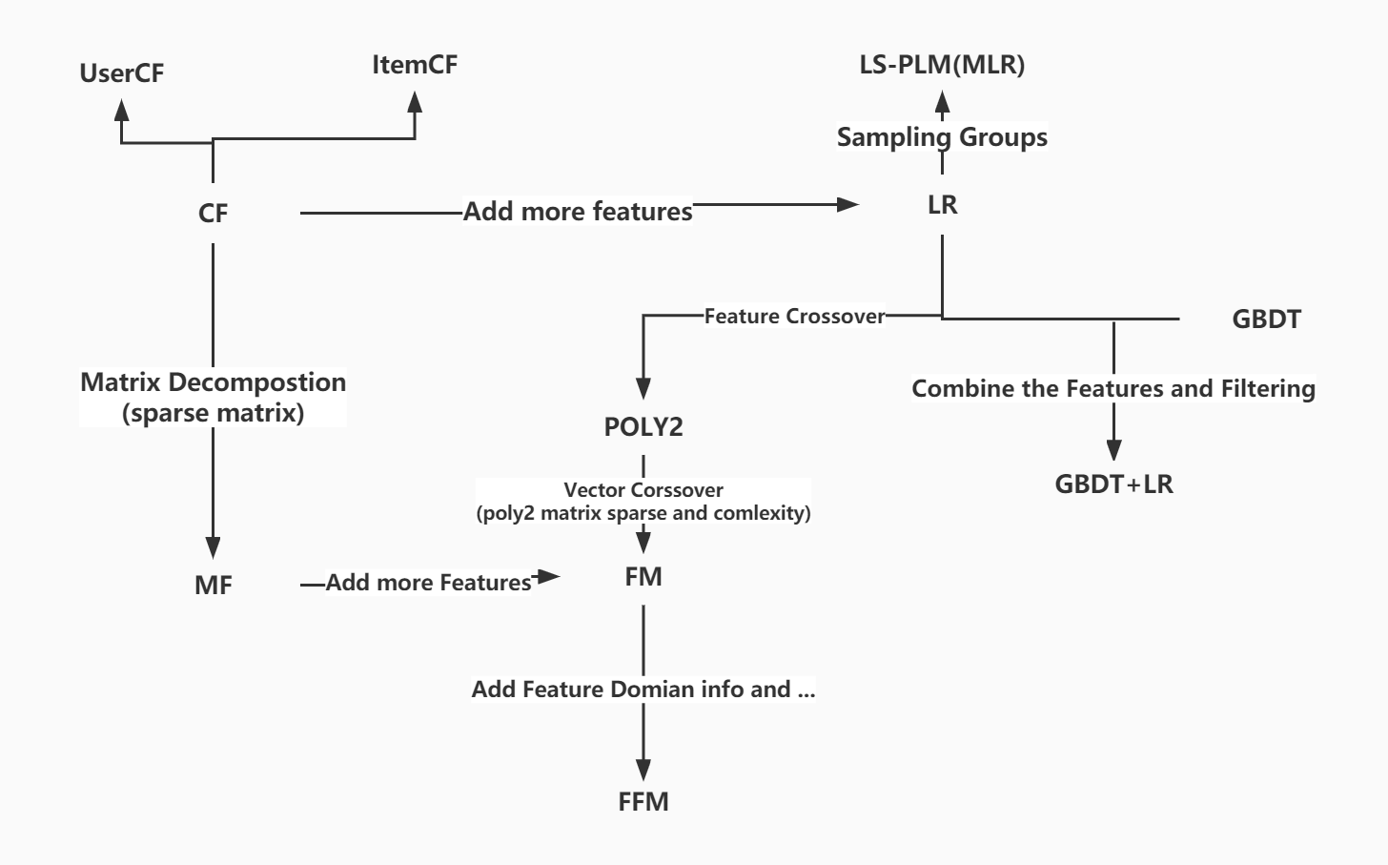
Abstract
How we learned the method we used

Slide 5
Advanced Recommendation models
DeepCrossing: 2016 Microsoft
Product-based Neural Networks: 2016 SJTU
Wide&Deep Networks: 2016 Google
Deep&Cross Network: 2017 Stanford & Google
DeepFM Networks: 2017 Huawei
NFM Networks: 2017 ZJU and University of Singapore
eXtrme deepFM, Deep interest Networks, Deep Session Interest Networks,
FiBiNET, Autolnt

Slide 6
Feature Engineering
What is feature engineering? Why do we need it?
The dataset is so large, too many useless information and features can strongly influence the algorithm we used.
It aims to extract features from the original data to the greatest extent for the use of algorithms and models.
The use scheme of features. (Find the useful features, Evaluate it is useful or not.)
Obtain scheme. (How we can get these features?)
Preprocessing. (For only one feature, multiple features. )
Feature Monitoring. (When new data or feature comes in, how does the quality of our model change?)

Slide 7
Ensemble Learning
In supervised learning algorithms, the goal is to learn a stable model that performs well in all aspects (goal of Feature Engineer), but in practice this is often not the case, and sometimes we can only get multiple models with preferences (perform better in some aspects).
In practice, for this goal, we have many weak learning machines, which when combined, returns better results.
However, there’s two problems.
how do we know which weak learning machine prefer which field?
How to combine the total result together?

Slide 8
Ensemble Learning
Three methods can solve these problems: Bagging, Boosting and Stacking.
Bagging: Random Forest
Boosting: Adaboosting, GBDT, Xgboosting.
Stacking: Train a model for combining each of the other models. In practice, usually use LR as the combine method.

Slide 9
Ensemble Learning
Bagging + DT = Random Forest
AdaBoost + DT = Boosting Tree
Gradient Boosting + DT = GBDT

Slide 10
02
Models

Slide 11
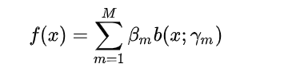
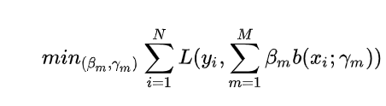
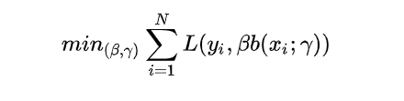
Boosting Tree
additive model:
forward stagewise algorithm:

Slide 12
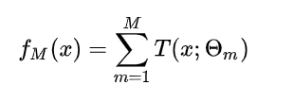


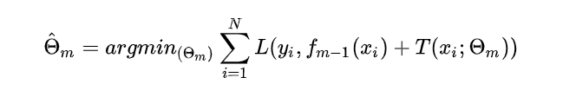
Boosting Tree
Boosting tree:
Boosting tree algorithm:

Slide 13
Gradient Boosting
The boosting tree use Additive model and FS Algorithm for getting the OPT
However, when the Loss is not Squared error or Exponential loss, the optimal for each step is not easy.
Friedman presents gradient boosting.
The idea is borrowed from gradient descent, and its basic principle is to train newly added weak classifiers based on the negative gradient information of the loss function of the current model, and then combine the trained weak classifiers into the existing model in an accumulative form.

Slide 14






Gradient Boosting
Gradient Descent
Gradient Boosting

Slide 15
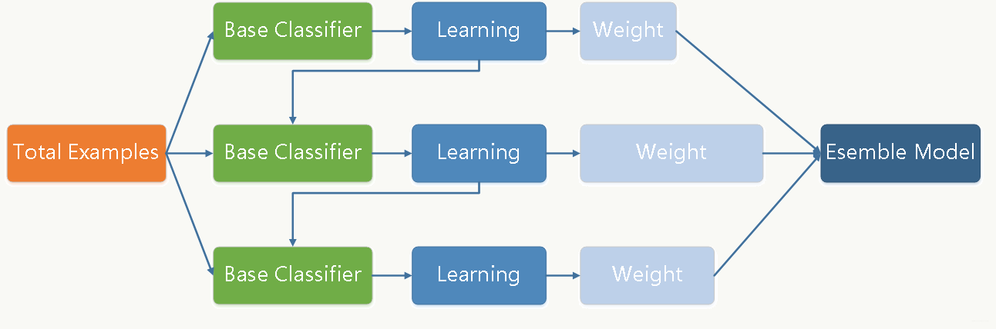
GBDT
When the f(x) = CART, we have GBDT

Slide 16
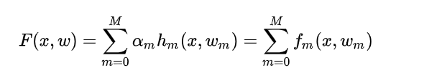

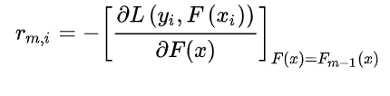

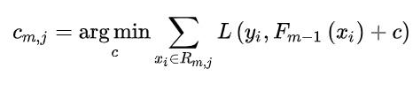
GBDT
M trees add together:
F0(x) is the weak classifier:
Build M trees m = 1,2,...M
Calculate the negative loss Gradient i.e. Pseudo Residuals
Using CART to fit data
For leaf J:

Slide 17

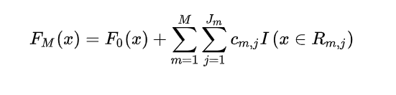
GBDT
Update the Strong Classifier Fm(x)
The Final FM(x)

Slide 18
GBDT
Difference and relationship to Adaboost:
AdaBoost improves the model by adjusting the weights of the error points, GBDT improves the model by calculating the negative gradient. Therefore, compared to AdaBoost, GBDT can use more kinds of objective functions.

Slide 19
GBDT
Different and relationship to RF
Bagging and Boosting
Variance and Bias: RF keep reducing the Variance; GBDT keep reducing the bias
Training set: RF is sampling; GBDT using the whole sample
Parallelism: RF generate tree at the same time; GBDT need to wait the previous tree
Final results: RF is voting(classification) and average (regression); GBDT is weighted combination
Data sensitivity: RF is not sensitive GBDT is sensitive to the outliner.
Generalization: RF not easy to overfitting but GBDT is easy.

Slide 20
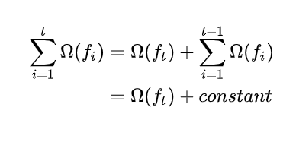
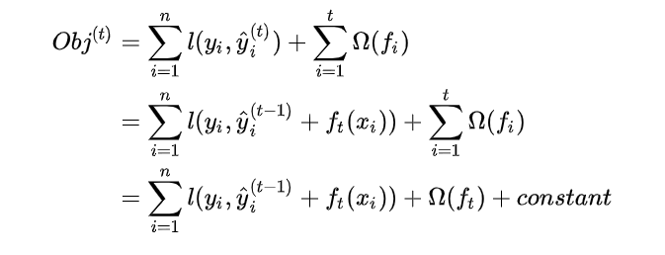
XGBoost
The different between GBDT and XGBoost is the objective function
The accuracy decided by Bias and Variance: Loss + Regularization
The XGBoost is boosting, also follow the Forward stagewise algorithm
The previous t - 1 trees was defined, so the 1 to t - 1 trees can be defined as a constant
So the objective can be defined:

Slide 21
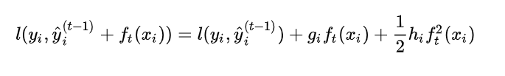
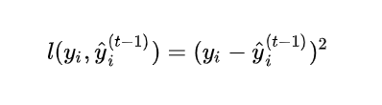
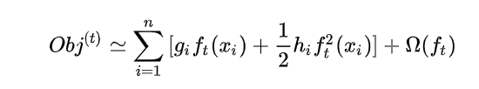
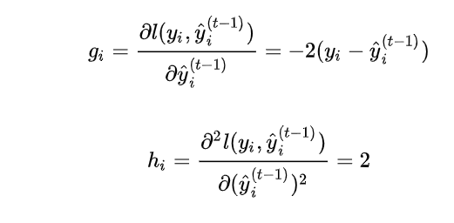
XGBoost
If the loss is MSE:

Slide 22

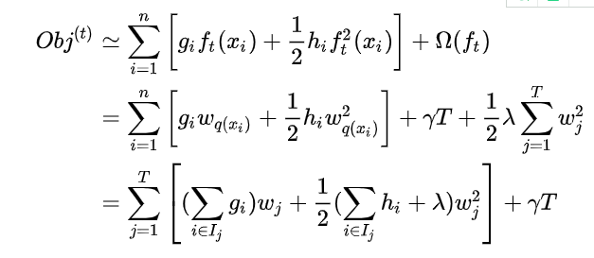
XGBoost
Group of leaves:
put all samples xi belonging to the first j leaf node into a same sample set of leaf nodes

Slide 23
XGBoost
Advantage:
High accuracy
Flexibility
Regularization
Shrinkage
Column Sampling
Missing Value
Concurrency
Approximation
Disadvantage:
Complex:
Although the computational effort of finding the best splitting point can be reduced by using pre-ranking and approximation algorithms, it is still necessary to traverse the dataset during node splitting.
Space
Pre-ranking need double space

Slide 24
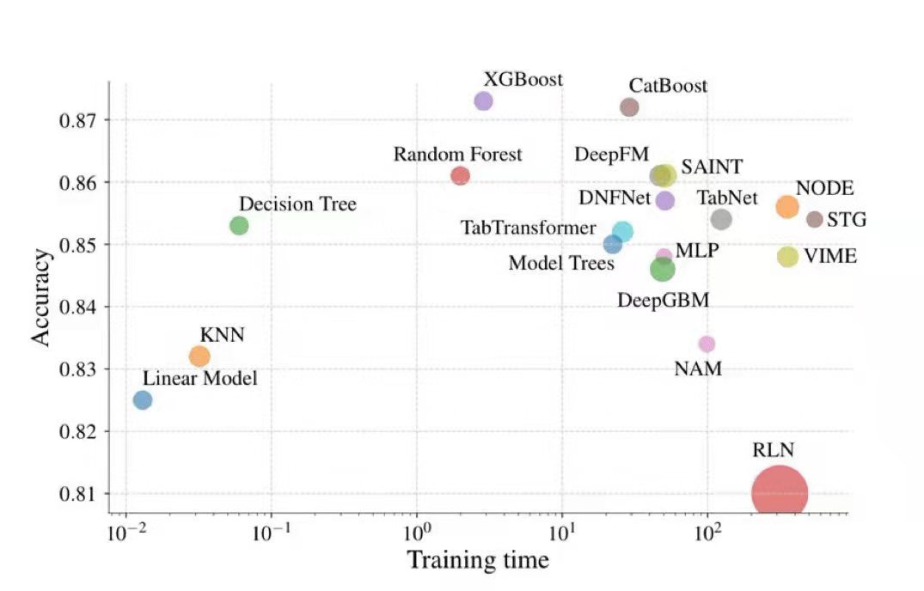
XGBoost in tabular data

Slide 25
03
Implementation

Slide 26
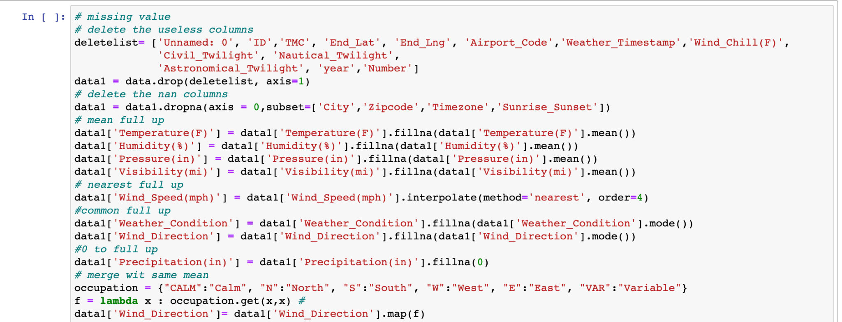
Preprocessing

Slide 27
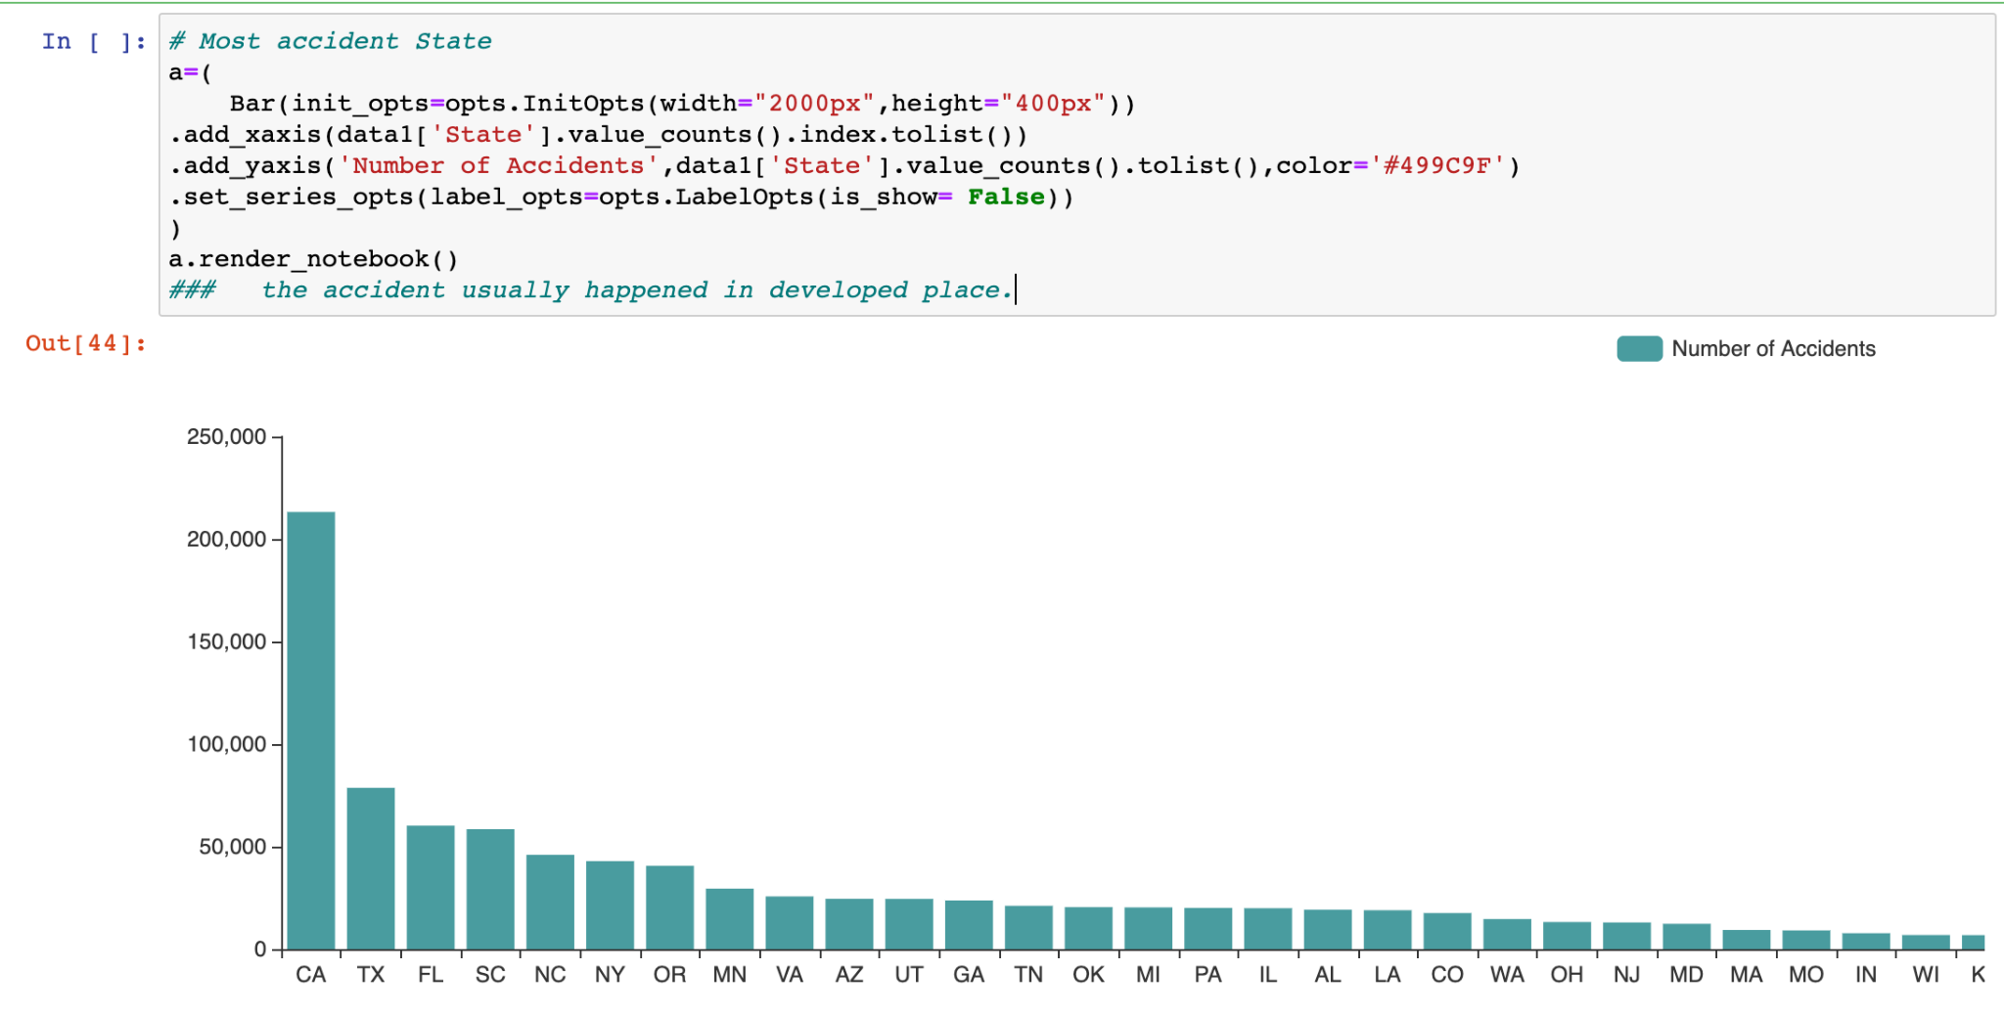
Ranking of States by Total Accidents

Slide 28
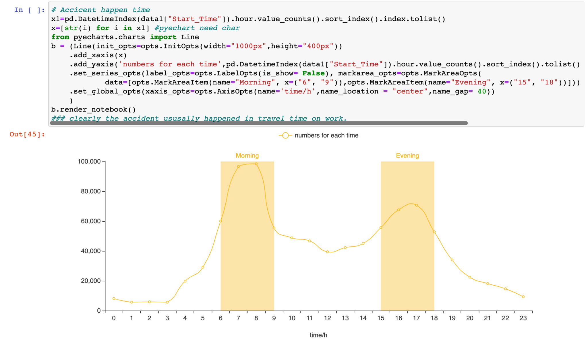
Frequency of Accident by Starting Time

Slide 29
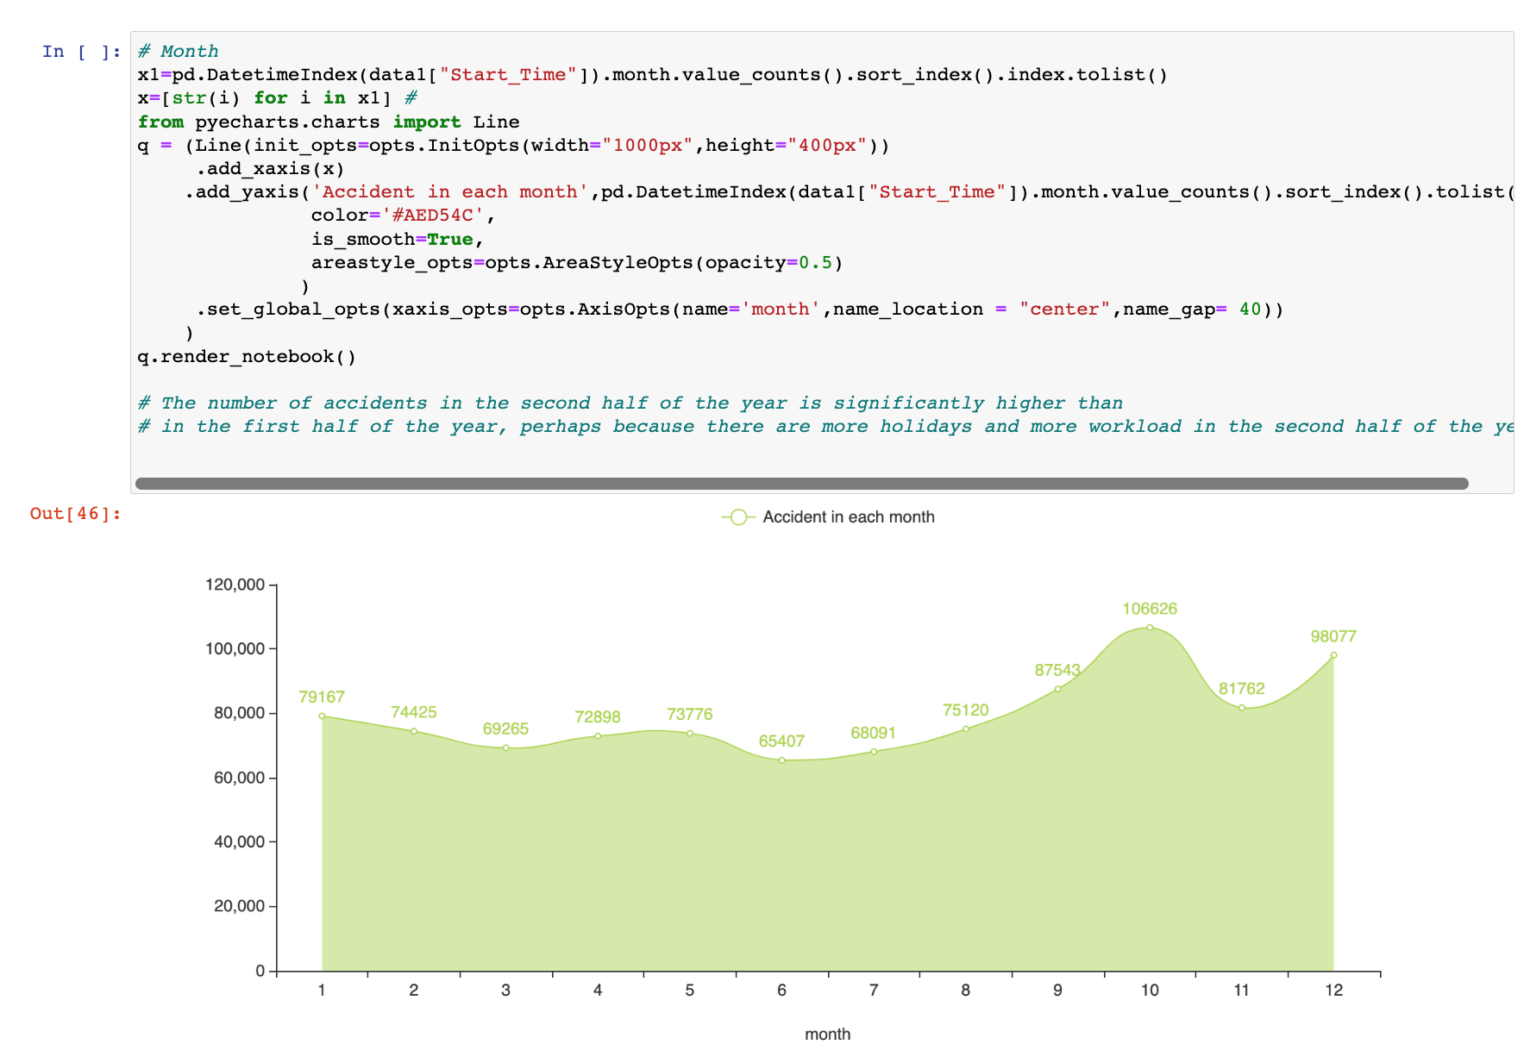
Accident Totals by Month

Slide 30
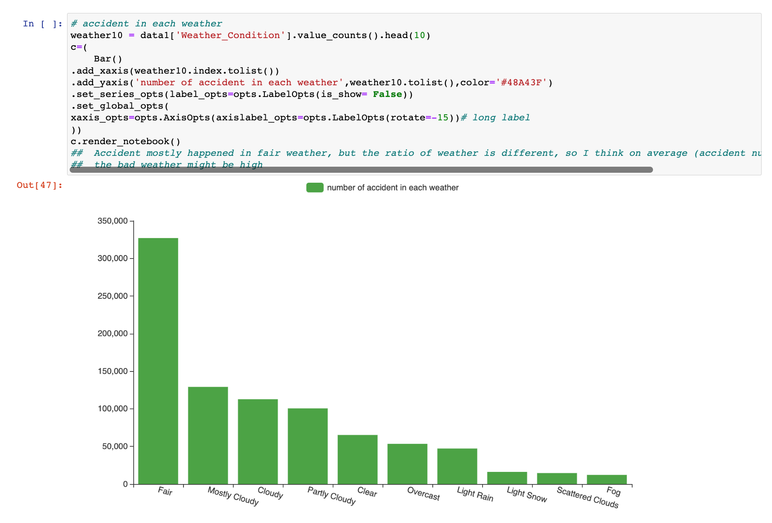
Accident Totals by Weather Condition

Slide 31
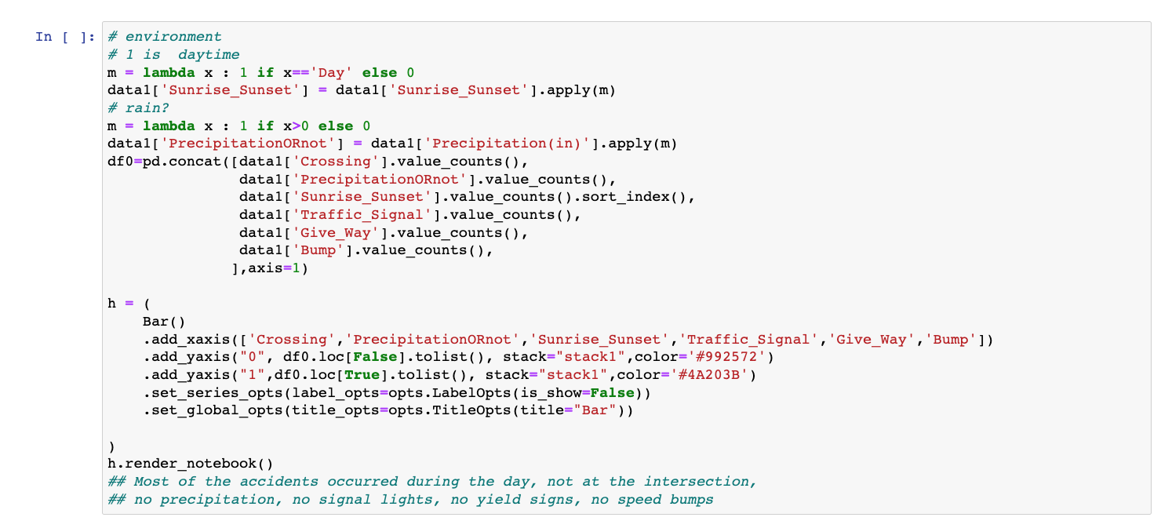
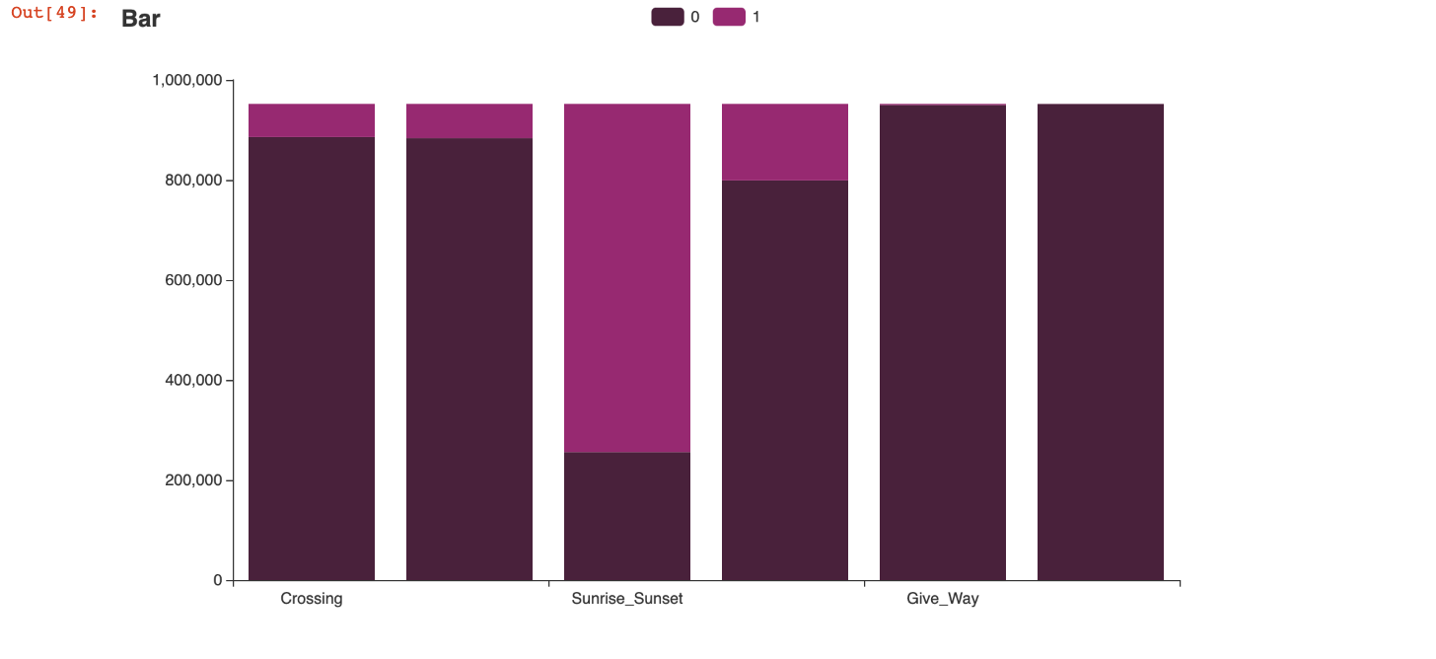
Accident Totals by Environment Conditions
1: Accidents occurred during labelled event
0: No accident during that event

Slide 32
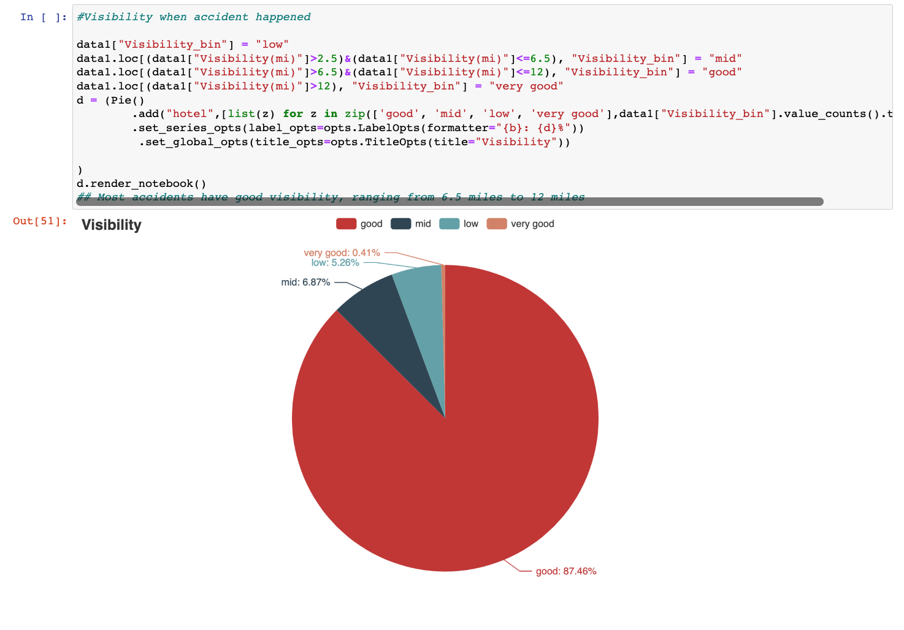
Accidents Sorted by Visibility

Slide 33
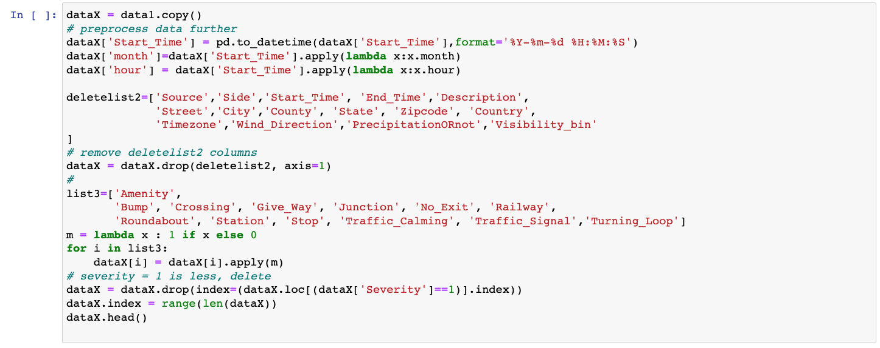
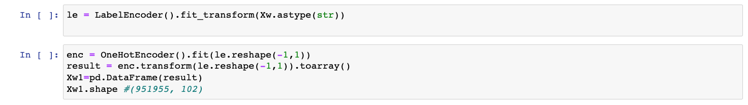
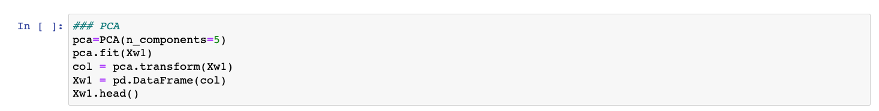
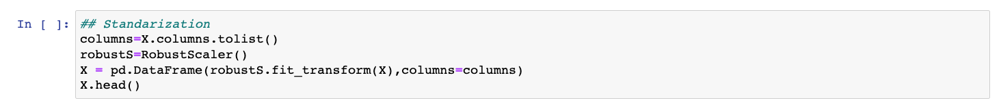
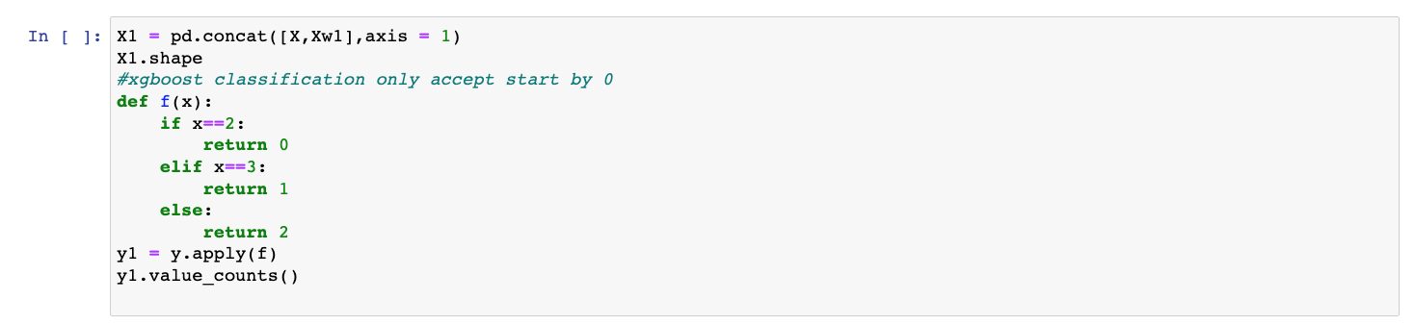
Removing Irrelevant Features,
Further Preprocessing for Pre- Model Training

Slide 34
04
Result

Slide 35
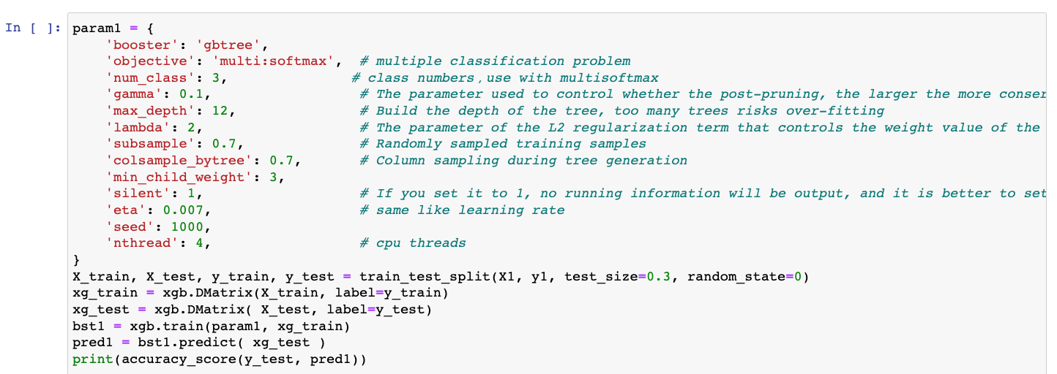
Accuracy of Model
Accuracy:

Slide 36
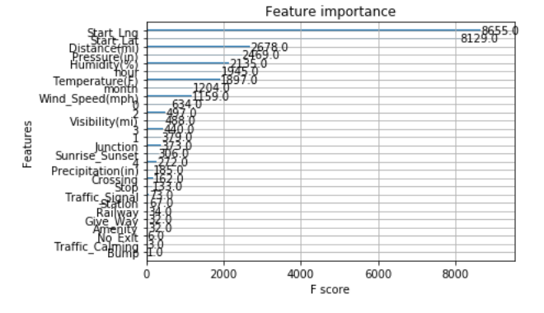
Importance of each feature with respect to Severity of Accident

Slide 37
05
Q/A

